Slide 1
Unit I Introduction to Big Data Analytics
Dr Purnima Gandhi

Slide 2
Data vs. Big Data
Data Vs. Big Data

Slide 3
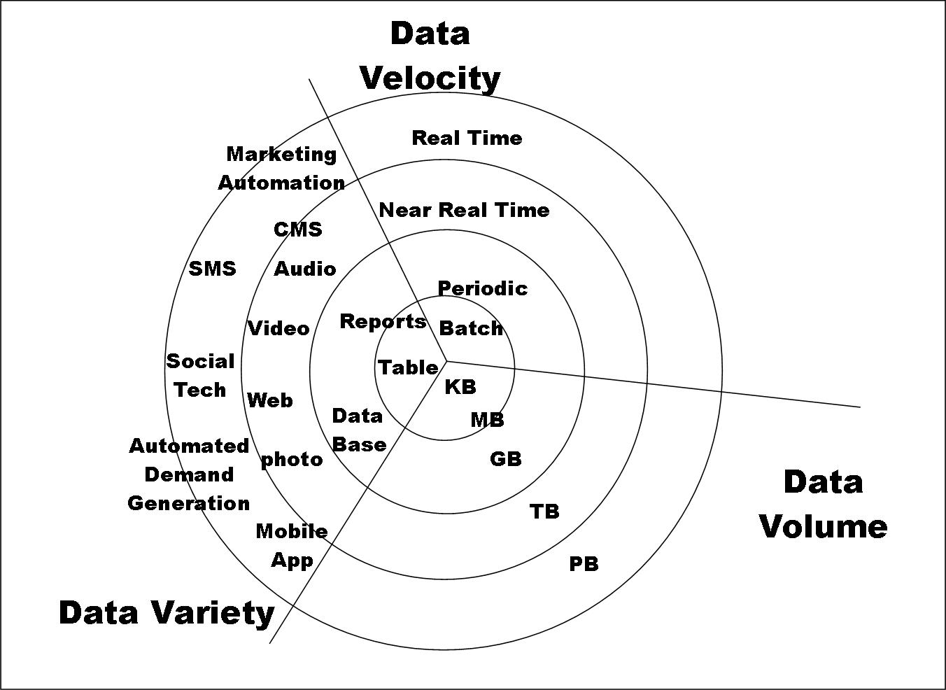
Big Data characteristics

Slide 4

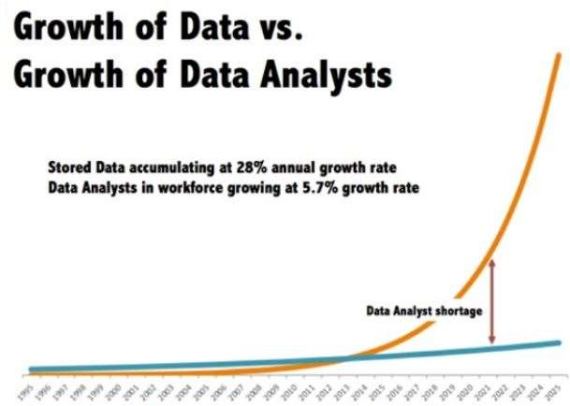
Why we are talking about Big data and data science?
Source: https://bit.ly/31HBHuQ

Slide 5
Traditional data vs. Big Data
 | Traditional data | Big data
Volume | GB | Constantly updated (PB to TB currently..)
Data generated rate | Per hour, day, … | More rapid
Structure | Structured | Semi-structured , unstructured
Data source | Centralized | Fully distributed
Data integration | Easy | Difficult
Data store | RDBMS | HDFS, NoSQL
Access | Interactive | Batch or real time/ near real time

Slide 6
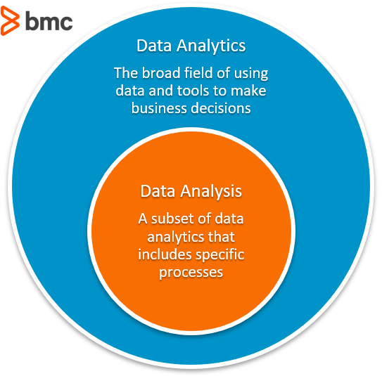
Analysis vs Analytics
Mathematics and statistics
Aggregation and Statistics
Data warehousing and OLAP
Indexing, Searching, and Querying
Keyword based search
Pattern matching (XML/RDF)
Knowledge discovery
Data Mining
Statistical Modeling
Machine learning
Artificial intelligence
Many more…………………….

Slide 7
Big Data
No single standard definition…
“Big Data” is data
Whose scale, diversity, and complexity require new architecture, techniques, algorithms, & analytics to manage it and extract value & hidden knowledge from it…
“Big data refers to data sets whose size is beyond the ability of typical database software tools to capture, store, manage and analyze.” -The McKinsey Global Institute, 2012

Slide 8
Big Data pipeline
Big Data Analytics is interdisciplinary and emerging technology
BDA is not strait forward
The term "data pipeline" describes a set of processes that move data from one place to another place. ... Big data pipelines can also use the same transformations and load data into a variety of depositories, including relational databases, data lakes, and data warehouses.

Slide 9
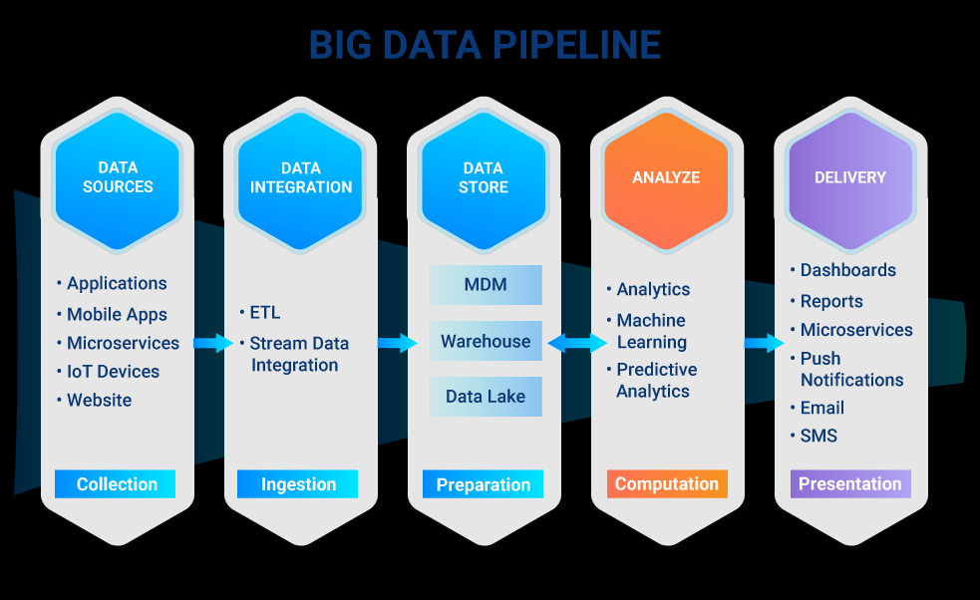
Big Data pipeline

Slide 10
A big data analytics cycle can be described by the following stage −
Business Problem Definition
Data Identification
Data Acquisition & Filtering
Data Extraction
Exploratory Data Analysis
Data Preparation for Modeling and Assessment
Data Visualization
Analysis of Results

Slide 11
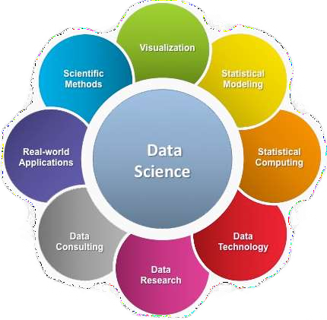
What is data science?
A multi-disciplinary and emerging field that uses scientific methods, processes, algorithms and systems to extract knowledge and insights from structured and unstructured data.
Goal - Turn data (Data science principles apply to all data – big and small ) into data products and create business value.
Source: https://bit.ly/30dekJB

Slide 12
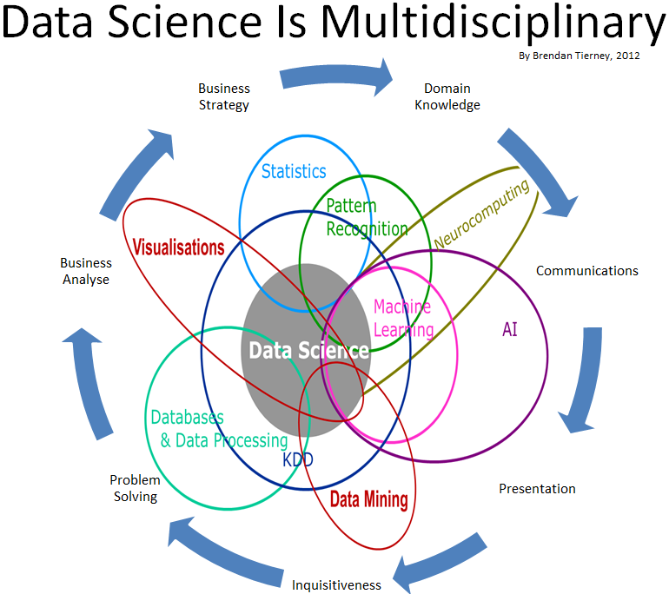

Slide 13
Big Data and Data Science
“… the sexy job in the next 10 years will be statisticians,” Hal Varian, Google Chief Economist
The U.S. will need 140,000-190,000 predictive analysts and 1.5 million managers/analysts by 2018. McKinsey Global Institute’s June 2011
New Data Science institutes being created or repurposed – NYU, Columbia, Washington, UCB,...
New degree programs, courses, boot-camps:
e.g., at Berkeley: Stats, I-School, CS, Astronomy…
One proposal (elsewhere) for an MS in “Big Data Science”

